Slide 1
IcedID Lab
CYBERDEFENDER
A cyber threat group was identified for initiating widespread phishing campaigns to distribute further malicious payloads. The most frequently encountered payloads were IcedID. You have been given a hash of an IcedID sample to analyze and monitor the activities of this advanced persistent threat (APT) group.

Slide 2

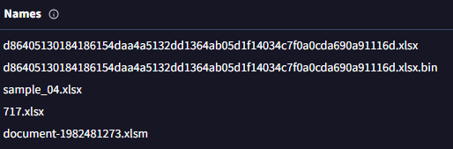
File’s SHA256 hash:
191eda0c539d284b29efe556abb05cd75a9077a0
It is identified by several names; we must write the one that fits the cell.

Slide 3
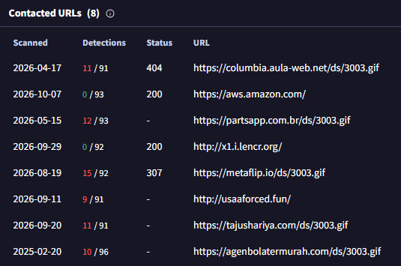


We can extract the GIF name, the domains it accesses, and the number of domains.

Slide 4
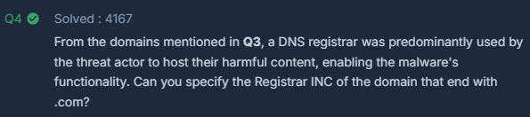
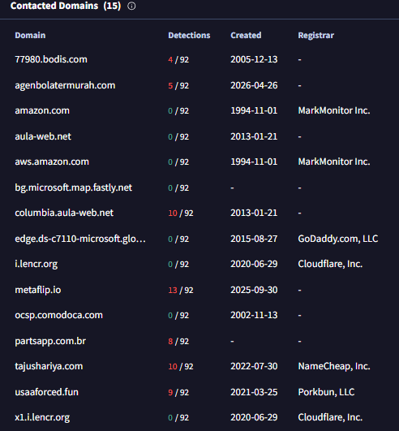
Registrar INC is observed for only one of the five domains in question.

Slide 5

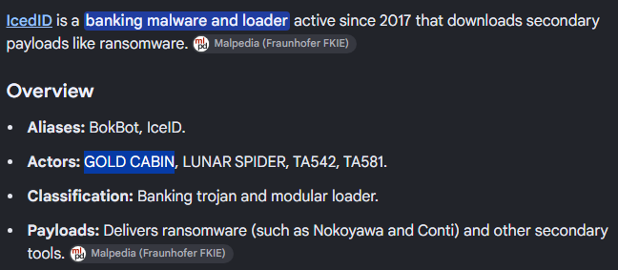
We can see this result by typing "IcedID" into the Chrome search bar.

Slide 6

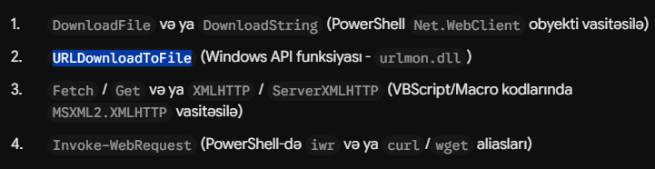
The answer is URLDownloadToFileA. URLDownloadToFile is a generic macro; if the text consists of ASCII characters, it resolves to URLDownloadToFileA, whereas if it consists of Unicode (UTF-16) characters, it resolves to URLDownloadToFileW. Based on our analysis—and assuming the use of ASCII characters given the age of the malware—we determine that the answer is URLDownloadToFileA.

